Slide 1
GENERATING YARA RULES TO DETECT MALWARE
PIP104 University Project-II
Review-2
Batch number : 45
Roll Number | Student Name
20201CCS0064 | SANTHOSH G
20201CCS0040 | DHANUSHRAGAVENDAR S
20201CCS0037 | VIGNESH R
20201CCS0013 | S AAQIB
Under the Supervision of,
Ms.SOUMYA
Assistant Professor
School of Computer Science & Engineering
Presidency University

Slide 2
Introduction
Yara rules are a powerful tool for identifying and classifying malware based on patterns and characteristics.
They are written in a specific syntax and can be used in various security applications.
Purpose :
It allows security professionals to create custom rules for detecting specific patterns associated with malicious software.
Application Areas :
Widely used in cybersecurity for scanning files, memory, or network traffic to identify potential security threats.

Slide 3
Literature Review
Title of the project : YARA-Signator: Automated Generation of Code-based YARA Rules.(2023)
Summary :
The paper proposes YARA-Signator, a framework for automated generation of code-based YARA rules.
YARA-Signator isolates instruction n-grams (sequences of fixed length instructions) that frequently appear within a malware family but are not found in any other family.
These unique n-grams form the basis for YARA rule strings that can reliably detect and identify malware families.
Drawback :
The approach was only tested on the Malpedia dataset, which mainly contains Windows malware. It's not clear how well it would generalize to other platforms or datasets.

Slide 4
Literature Review
Title of the project: YAMME: a YAra-byte-signatures Metamorphic Mutation Engine(2023)
Summary:
The paper presents YAMME (Yara-byte-signatures Metamorphic Mutation Engine), an algorithm that employs metamorphic obfuscation techniques to strengthen YARA rules against evasion attempts.
YAMME first rewrites YARA byte-signatures in several equivalent ways, similar to how a metamorphic mutation engine would operate.
It then introduces an optimization phase to compact the strings produced and reduce computational overhead, providing different YARA rule formats.
Drawback :
Potential for increased false positives. Mutating YARA rules in multiple ways increases the search space and risk of capturing benign files/behavior as well. The paper found this effect varied based on the rule format/optimization applied.

Slide 5
Literature Review
Title of the project: Automatic YARA Rule Generation(2021)
Summary:
The goal of this research is to automatically generate YARA signatures for known malware samples in an efficient way to assist analysts.
The machine learning algorithm used for scoring string literals extracted from malware samples is the Naïve Bayes algorithm.
The proposed approach uses a data-driven scoring system and handles larger sample sizes better than existing tools.
Drawback :
The paper only compared its proposed approach with some older rule generation tools like yarGen, yarGenerator, and yaBin. It did not compare with the latest tools like AVClass which may perform better.

Slide 6
Yara Rule Examples
Ransomware :
Encrypts files on a victimd's system and demands payment (usually in cryptocurrency) for the decryption key.
2. Spyware :
Secretly monitors user activities, gathers sensitive information, and sends it to a third party without the user's knowledge.
3. Viruses :
Malicious code that attaches itself to legitimate programs or files, replicating when the host program is executed.

Slide 7
Yara Rule Examples
4. Trojans (Trojan Horses) :
Disguises itself as legitimate software but contains a malicious payload. Trojans do not replicate like viruses but can cause significant damage.
5. Keyloggers :
Records keystrokes on a computer, allowing attackers to capture sensitive information like login credentials.
6. Browser Hijackers :
Takes control of a web browser, altering settings, redirecting searches, or displaying unwanted content.

Slide 8
Objectives
Automated Rule Generation:
This objective aims to reduce the manual effort and time required for creating YARA rules, thereby increasing the efficiency of signature generation.
2.User-Friendly Interface:
This objective is to design a user-friendly platform that simplifies the process of specifying file sets, initiating rule generation, and analyzing results.

Slide 9
Objectives
3.Validation and Testing:
This includes testing the signatures on diverse malware samples and benchmarking against known datasets.
4.Cost-Efficiency:
An objective is to offer a cost-efficient solution that helps organizations reduce manual labor and resource costs associated with YARA rule creation and malware analysis

Slide 10
Methodology
Define the Target
Research and Analysis
Sample Analysis
Use Search Engines
Pattern Identification
Create YARA Rules

Slide 11
Expected Outcomes
Automated Rule Generation:
This will result in a significant reduction in the time and effort required to create YARA signatures, allowing security professionals to keep pace with evolving malware threats efficiently.
2. Time-Efficient Scanning:
This will enable security analysts to swiftly identify the best signature candidates, thereby improving the efficiency of malware detection and reducing the time required for threat assessment.

Slide 12
Expected outcomes
3. Generic YARA Rules:
This is expected to lead to improved malware detection and the ability to catch a broader range of malware variants.
4. Enhanced Security:
This will result in better protection against evolving threats and a reduced risk of false negatives.
5. Reduced Manual Workload:
This frees up valuable time and resources that can be better utilized for other critical security tasks.

Slide 13
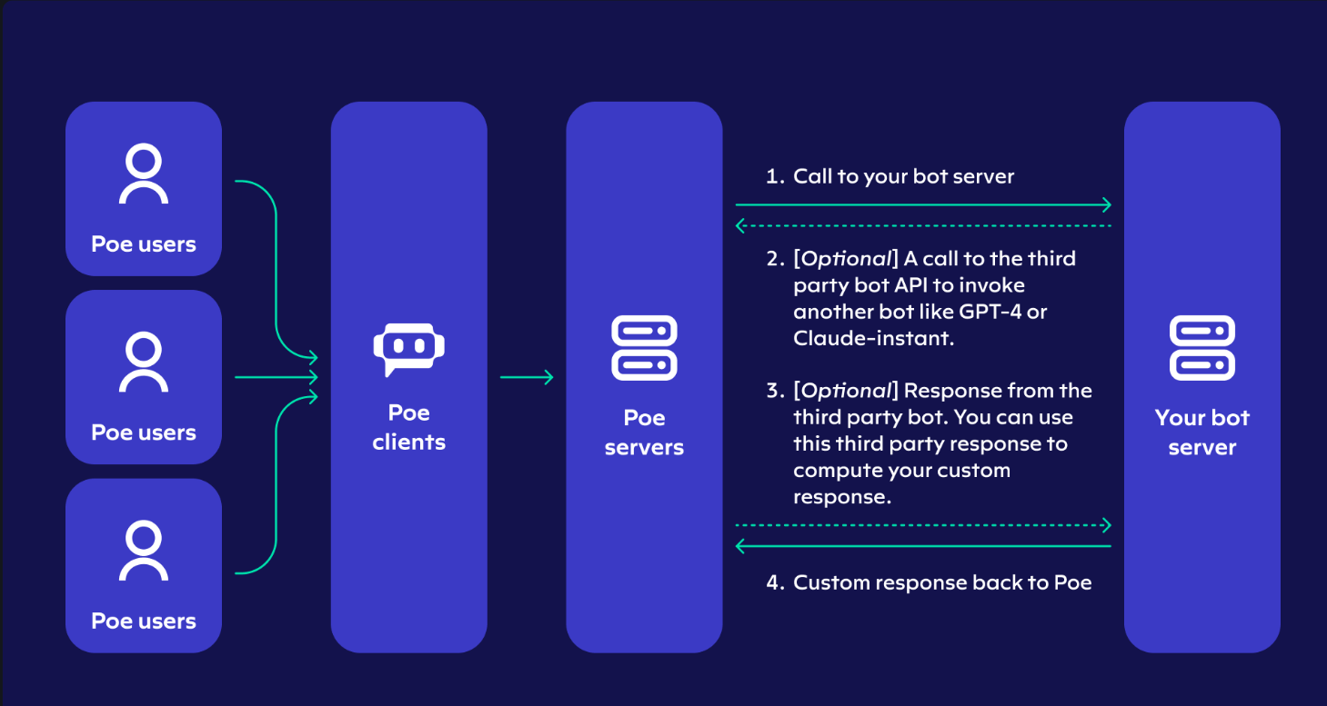
Proposed method

Slide 14
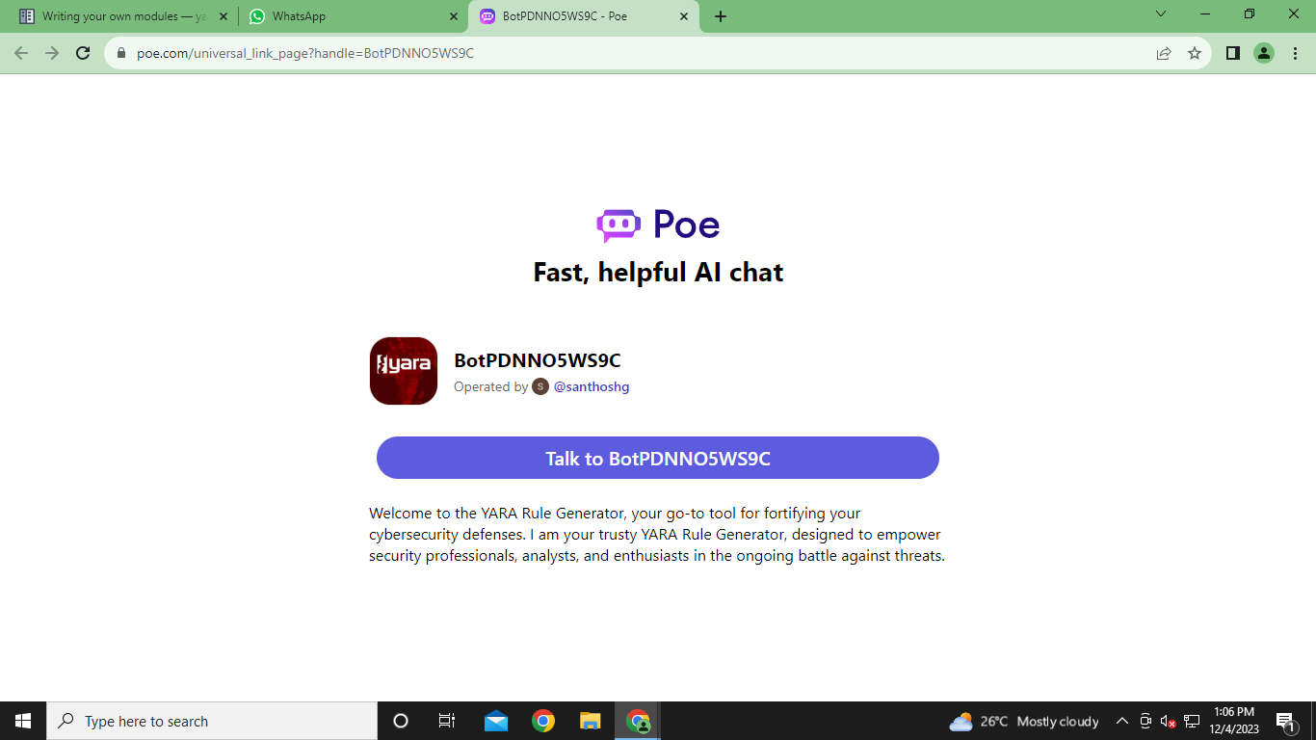
Login page

Slide 15
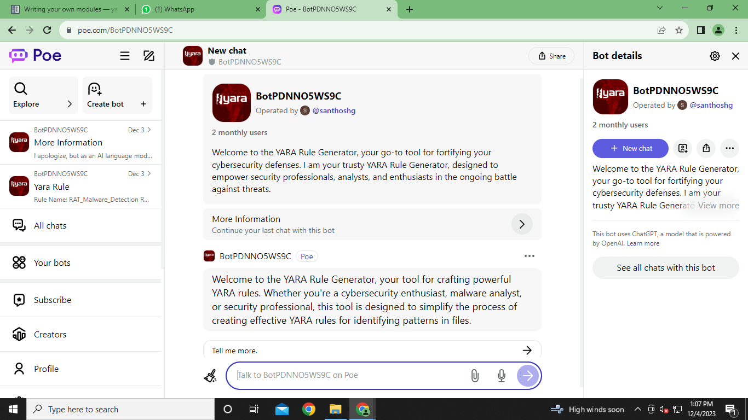
Initial interface after login

Slide 16
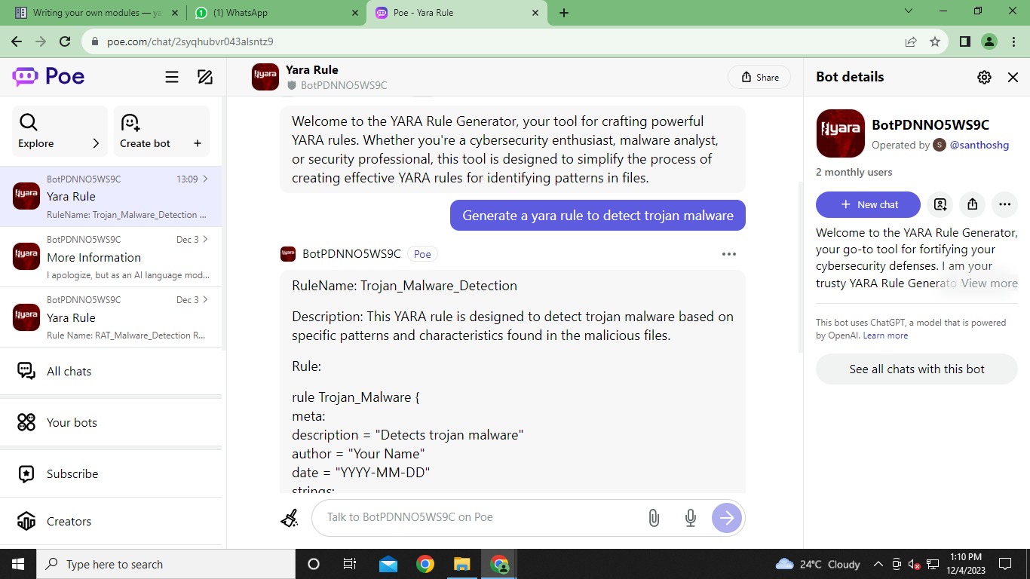
Generate a yara rule to detect Trojan malwares

Slide 17
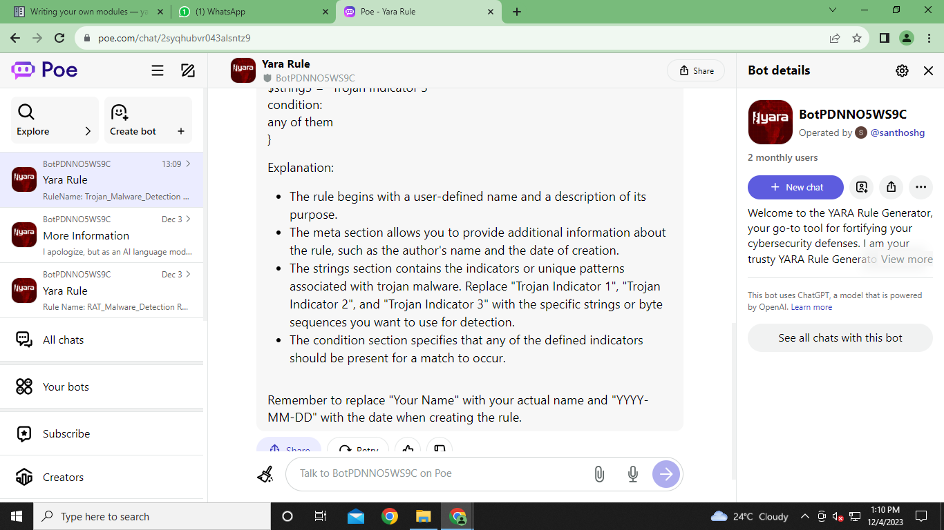
Output

Slide 18
Conclusion
In conclusion, YARA rules represent a powerful and adaptable tool in the cybersecurity arsenal.
Their precision, community-driven nature, and integration capabilities make them a valuable asset in the ongoing battle against cyber threats.
The cybersecurity community, combined with the effectiveness of YARA rules, will play a pivotal role in securing digital environments.

Slide 19
References
YARA Official Documentation: The official documentation for YARA (https://yara.readthedocs.io/en/stable/) is a valuable resource for understanding the YARA language, signature creation, and usage.
Academic Journals and Conferences: Look for academic papers, articles, and conference papers related to malware detection, signature generation, and YARA rules. Journals like the Journal of Computer Virology and Hacking Techniques and conferences like the ACM Conference on Computer and Communications Security often publish research in this area.
Cybersecurity Research Organizations: Check the publications and reports from cybersecurity research organizations like Symantec,

Slide 20
References
Kaspersky Lab, McAfee, and others. They often share insights into malware detection techniques.
Online Forums and Communities: Websites and forums like the YARA Rules Project (https://github.com/Yara-Rules/rules) can be useful for finding discussions, tutorials, and examples related to YARA rules and signature creation.

Slide 21
Thank You

